Slide 1

Intro to Cybersecurity
Welcome to the week of Cybersecurity!

Slide 2
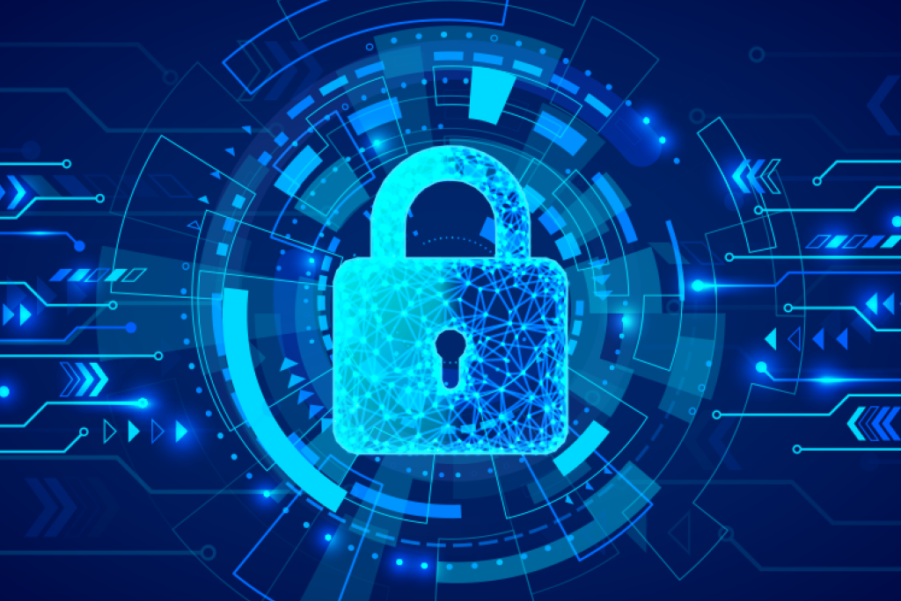
What is Cyber Security
The word Cybersecurity means services offered to someone, or a group of people, to protect them from somebody stealing their online information.
What kind of Information can be stolen?
Names and Home Addresses
Credit Cards and Payment Data
Medical Records
Passwords
Classified Information

Slide 3

With the internet constantly growing in size and with so many people connected to the internet, cyber crimes and security threats are also increasing.

Slide 4

Why have Cybersecurity
Cybersecurity is very important today since it helps people secure their information stored on their computer from people trying to hack information, and it also helps prevent your computer from any bad viruses
Apple, Amazon, YouTube, Walmart, or any other company you can think of have a cybersecurity team to protect their company from cyber attacks

Slide 5
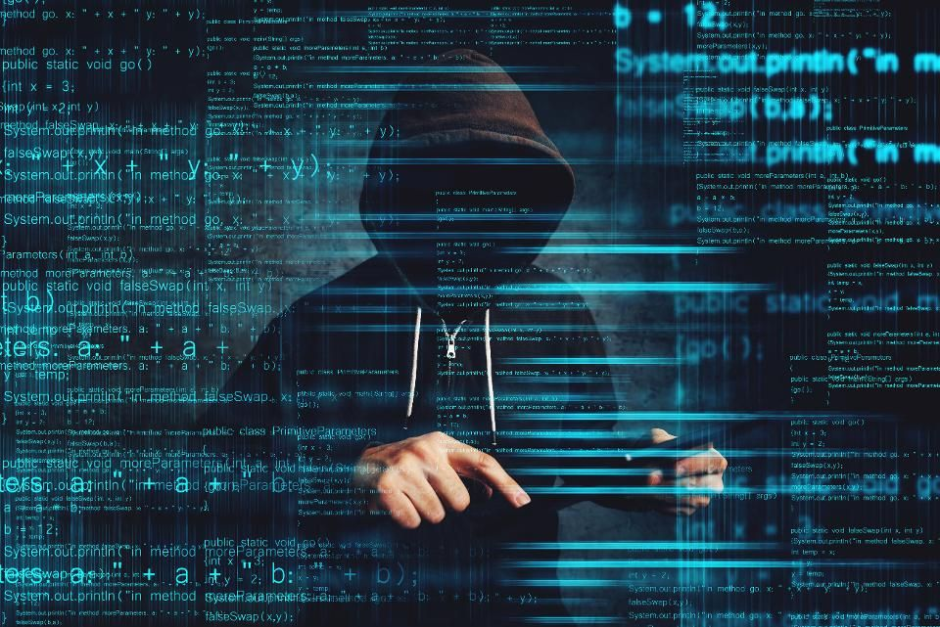
Who is behind Cyber Attacks?
Most commonly known, the hacker is a person who tries to break into computers by gaining control over the computer in sneaky ways. It can be hard to protect your computer from hackers, but there are many great ways you can protect yourself from these kinds of people!

Slide 6

Futures in the field of Cybersecurity
There are very cool jobs you can have that are based around cybersecurity, those including jobs in
The FBI
State Police
Hospitals
Professional Sports Teams
Large and Small Companies
Just about whatever you see yourself in the future, cybersecurity could be there too!

Slide 7
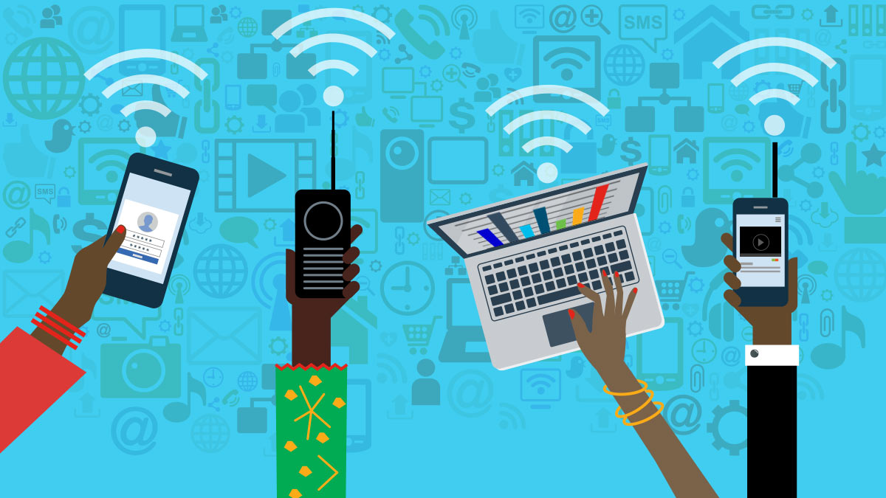
How does Cybersecurity apply to you?
Just by you searching everyday things on the web, watching videos, clicking links, and playing games, you can find yourself downloading material that could make your computer more vulnerable to a virus. Or you can give a website information that they can use in bad ways.
The internet is a fantastic tool to use which is why everyone uses it regularly, most of the internet is good! It is just small amount of bad we have to be careful of.

Slide 8


How you can easily practice Cybersecurity!
You can practice Cybersecurity just about everyday, here are some easy ways to protect yourself and your personal information from those bad hackers…
Don’t use the same password for everything! Use different passwords and make each unique.
Make your passwords long and hard to guess, and store them in a password manager.
Don’t click on weird links or ads you may come across on the internet that seem unprofessional.
Don’t share your passwords, only with your parents!

Slide 9
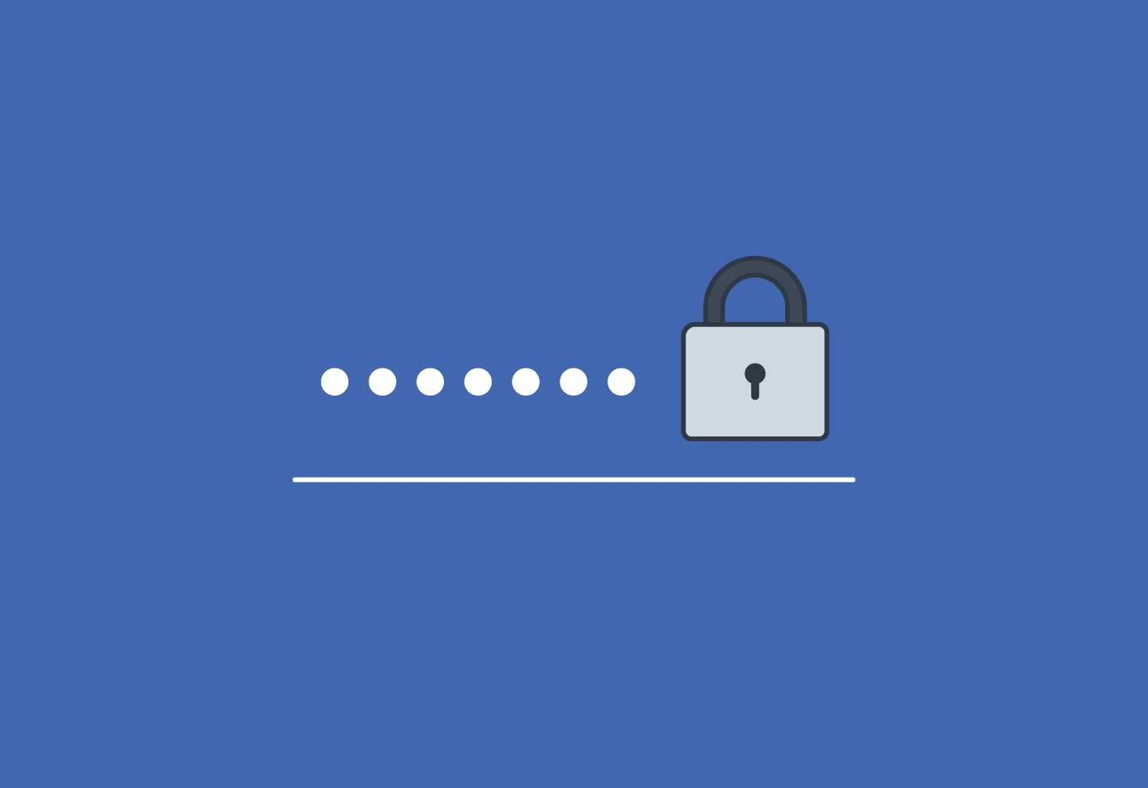
Now lets begin and see how easy it could be to figure out a password!

